Slide 1
Vision
An introduction to the
All UK marine data are
Dr Clare Postlethwaite
cfpo@noc.ac.uk
Notes:
Add CBA

Slide 2
Aims of the meeting
share marine data successes
discuss priorities for enhancing the national framework for sharing UK marine data
Celebrate 15 years of MEDIN
‘measure once, use many times’

Slide 3
MEDIN established
Marine Gazetteer republished
Metadata standard published
First data guideline published
Review of access to industry data
‘2 clicks to data’ initiative
2022
1995
2021
2008
2009
2020
2010
2011
2012
2014
2019
2023
2013
2016
2017
2018
2015
MEDIN precursor established
Trialled new API standard, a global first
MEDIN DAC network expanded
MEDIN DAC network established
Training workshops moved online
MEDIN portal redeveloped
MEDIN portal launched
Benefit to cost ratio estimated at 8:1
Value chains in public marine data
UKDMOS launched
With thanks and acknowledgement to all the sponsors and partners helping to deliver MEDIN’s vision.
@MEDIN_marine

Slide 4
MEDIN established
Marine Gazetteer republished
MEDIN established
First data guideline published
Metadata standard published
Review of access to industry data
‘2 clicks to data’ initiative
2022
2005
2021
2008
2009
2020
2010
2011
2012
2014
2019
2023
2013
2016
2017
2018
2015
MEDIN precursor established
Trialled new API standard, a global first
MEDIN DAC network expanded
MEDIN DAC network established
Training workshops moved online
MEDIN portal redeveloped
MEDIN portal launched
Benefit to cost ratio estimated at 8:1
Value chains in public marine data
UKDMOS launched
With thanks and acknowledgement to all the sponsors and partners helping to deliver MEDIN’s vision.
@MEDIN_marine

Slide 5
Marine Gazetteer republished
2008
MEDIN established
as a fully funded long-term programme under the Marine Science Coordination Committee.
MEDIN aims to improve access to, and management of UK marine environmental data.
MEDIN is an open partnership funded by 15 sponsors and hosted at the
National Oceanography Centre.
MEDIN’s strapline ‘measure once, use many times’ has been adopted around the world.
MEDIN provides the national framework for managing UK marine data
MEDIN established
First data guideline published
Metadata standard published
Review of access to industry data
‘2 clicks to data’ initiative
2022
2005
2021
2008
2009
2010
2011
2012
2014
2019
2023
2013
2016
2017
2020
2015
2018
MEDIN precursor established
Training workshops moved online
MEDIN DAC network expanded
MEDIN DAC network established
MEDIN portal redeveloped
MEDIN portal launched
Benefit to cost ratio estimated at 8:1
Trialled new API standard, a global first
UKDMOS launched
With thanks and acknowledgement to all the sponsors and partners helping to deliver MEDIN’s vision.
@MEDIN_marine

Slide 6
MEDIN established
Marine Gazetteer republished
Metadata standard published
First data guideline published
Review of access to industry data
‘2 clicks to data’ initiative
2022
2005
2021
2008
2009
2020
2010
2011
2012
2014
2019
2023
2013
2016
2017
2018
2015
MEDIN precursor established
Trialled new API standard, a global first
MEDIN DAC network expanded
MEDIN DAC network established
Training workshops moved online
MEDIN portal redeveloped
MEDIN portal launched
Benefit to cost ratio estimated at 8:1
Value chains in public marine data
UKDMOS launched
With thanks and acknowledgement to all the sponsors and partners helping to deliver MEDIN’s vision.
@MEDIN_marine

Slide 7
Marine Gazetteer republished
2009
Data Archive Centre network established
as a coordinated network of specialist data repositories providing long-term access to UK marine data.
Originally 4 data centres, the network expanded over the years to 7 MEDIN data centres.
MEDIN established
First data guideline published
Metadata standard published
Review of access to industry data
‘2 clicks to data’ initiative
2022
2005
2021
2008
2009
2010
2011
2012
2014
2019
2023
2013
2016
2017
2020
2015
2018
MEDIN precursor established
Training workshops moved online
MEDIN DAC network expanded
MEDIN DAC network established
MEDIN portal redeveloped
Benefit to cost ratio estimated at 8:1
Trialled new API standard, a global first
UKDMOS launched
With thanks and acknowledgement to all the sponsors and partners helping to deliver MEDIN’s vision.
@MEDIN_marine

Slide 8
MEDIN established
Marine Gazetteer republished
Metadata standard published
First data guideline published
Review of access to industry data
‘2 clicks to data’ initiative
2022
2005
2021
2008
2009
2020
2010
2011
2012
2014
2019
2023
2013
2016
2017
2018
2015
MEDIN precursor established
Trialled new API standard, a global first
MEDIN DAC network expanded
MEDIN DAC network established
Training workshops moved online
MEDIN portal redeveloped
MEDIN portal launched
Benefit to cost ratio estimated at 8:1
Value chains in public marine data
UKDMOS launched
With thanks and acknowledgement to all the sponsors and partners helping to deliver MEDIN’s vision.
@MEDIN_marine

Slide 9
MEDIN established
Marine Gazetteer republished
2009
MEDIN discovery metadata standard first published
as a standardised way to describe UK marine geospatial data that complies with national and international standards such as GEMINI, INSPIRE and ISO.
We are currently exploring expanding the MEDIN standard to include non-spatial data.
Metadata standard published
First data guideline published
Review of access to industry data
‘2 clicks to data’ initiative
2022
2005
2021
2008
2009
2010
2011
2012
2014
2019
2023
2013
2016
2017
2020
2015
2018
New iterations released over the years based on marine user needs and changes to national and international standards.
Latest version published in 2022
MEDIN provides a range of tools to produce metadata that complies with the standard.
MEDIN precursor established
Training workshops moved online
MEDIN DAC network expanded
MEDIN DAC network established
Standard
Controlled vocabularies
MEDIN portal redeveloped
Benefit to cost ratio estimated at 8:1
Trialled new API standard, a global first
UKDMOS launched
With thanks and acknowledgement to all the sponsors and partners helping to deliver MEDIN’s vision.
@MEDIN_marine

Slide 10
MEDIN established
Marine Gazetteer republished
Metadata standard published
First data guideline published
Review of access to industry data
‘2 clicks to data’ initiative
2022
1995
2021
2008
2009
2020
2010
2011
2012
2014
2019
2023
2013
2016
2017
2018
2015
MEDIN precursor established
Trialled new API standard, a global first
MEDIN DAC network expanded
MEDIN DAC network established
Training workshops moved online
MEDIN portal redeveloped
MEDIN portal launched
Benefit to cost ratio estimated at 8:1
Value chains in public marine data
UKDMOS launched
With thanks and acknowledgement to all the sponsors and partners helping to deliver MEDIN’s vision.
@MEDIN_marine

Slide 11
MEDIN established
Marine Gazetteer republished
2010
MEDIN portal launched
as a single place to find UK marine data.
Originally holding 800 datasets, you can now find over 17,600 datasets owned or managed by more than 600 organisations.
https://portal.medin.org.uk/portal/start.php
Our portal was redeveloped in 2017 and new iterations released over the years based on user feedback.
In 2023, we made the content available using an Application Programming Interface (API)
Metadata standard published
First data guideline published
Review of access to industry data
‘2 clicks to data’ initiative
2022
1995
2021
2008
2009
2020
2010
2011
2012
2014
2019
2023
2013
2016
2017
2018
2015
MEDIN precursor established
Trialled new API standard, a global first
MEDIN DAC network expanded
MEDIN DAC network established
Training workshops moved online
MEDIN portal redeveloped
MEDIN portal launched
Benefit to cost ratio estimated at 8:1
Value chains in public marine data
UKDMOS launched
With thanks and acknowledgement to all the sponsors and partners helping to deliver MEDIN’s vision.
@MEDIN_marine

Slide 12
MEDIN established
Marine Gazetteer republished
Metadata standard published
First data guideline published
Review of access to industry data
‘2 clicks to data’ initiative
2022
1995
2021
2008
2009
2020
2010
2011
2012
2014
2019
2023
2013
2016
2017
2018
2015
MEDIN precursor established
Trialled new API standard, a global first
MEDIN DAC network expanded
MEDIN DAC network established
Training workshops moved online
MEDIN portal redeveloped
MEDIN portal launched
Benefit to cost ratio estimated at 8:1
Value chains in public marine data
UKDMOS launched
With thanks and acknowledgement to all the sponsors and partners helping to deliver MEDIN’s vision.
@MEDIN_marine

Slide 13
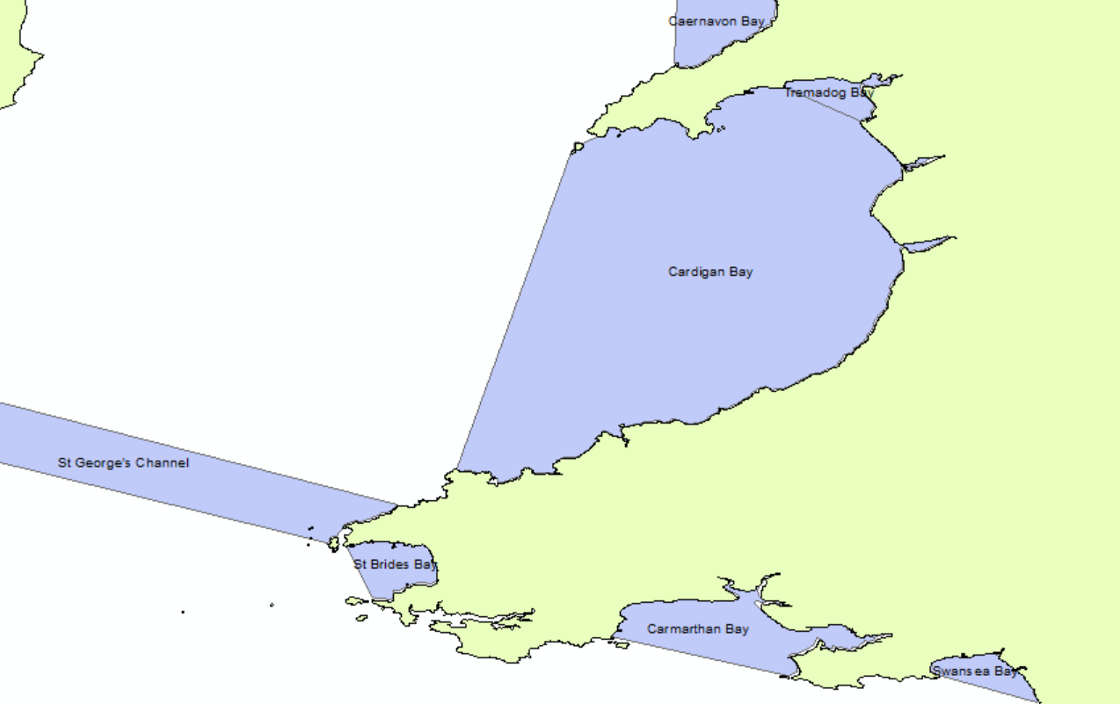
MEDIN established
Marine Gazetteer republished
2013
MEDIN republished UK Marine Gazetteer
This dataset, containing defined polygons of sea areas, and point locations of marine features such as Dogger Bank, Wolf Rock, Bude Bay etc, is an important reference dataset for all organisations working around UK and the GIS file can be downloaded from the MEDIN portal.
Metadata standard published
First data guideline published
Review of access to industry data
‘2 clicks to data’ initiative
2022
1995
2021
2008
2009
2020
2010
2011
2012
2014
2019
2023
2013
2016
2017
2018
2015
The UK Marine Gazetteer has been incorporated into global gazetteers such as SeaVox, which can be viewed as a reference layer on the MEDIN portal or accessed as a Web Map Service (WMS) from marineregions.org
MEDIN precursor established
Cardigan Bay
Trialled new API standard, a global first
MEDIN DAC network expanded
MEDIN DAC network established
Training workshops moved online
St George’s Channel
MEDIN portal redeveloped
MEDIN portal launched
Benefit to cost ratio estimated at 8:1
St Bride’s Bay
Value chains in public marine data
UKDMOS launched
With thanks and acknowledgement to all the sponsors and partners helping to deliver MEDIN’s vision.
@MEDIN_marine

Slide 14
MEDIN established
Marine Gazetteer republished
Metadata standard published
First data guideline published
Review of access to industry data
‘2 clicks to data’ initiative
2022
1995
2021
2008
2009
2020
2010
2011
2012
2014
2019
2023
2013
2016
2017
2018
2015
MEDIN precursor established
Trialled new API standard, a global first
MEDIN DAC network expanded
MEDIN DAC network established
Training workshops moved online
MEDIN portal redeveloped
MEDIN portal launched
Benefit to cost ratio estimated at 8:1
Value chains in public marine data
UKDMOS launched
With thanks and acknowledgement to all the sponsors and partners helping to deliver MEDIN’s vision.
@MEDIN_marine

Slide 15
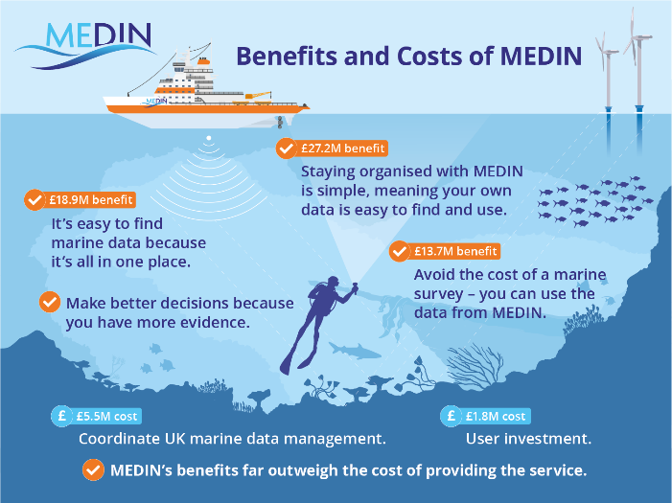
MEDIN established
Marine Gazetteer republished
2019
Benefit : cost ratio of MEDIN estimated as 8:1
Metadata standard published
First data guideline published
Review of access to industry data
‘2 clicks to data’ initiative
2022
1995
2021
2008
For the first time, environmental economists were able to provide a quantitative estimate of the value of MEDIN’s services.
MEDIN have gone on to work with the Organisation for Economic Cooperation and Development (OECD) and the Global Ocean Observing System (GOOS) to explore the reuse value of marine data.
2009
2020
2010
2011
2012
2014
2019
2023
2013
2016
2017
2018
2015
MEDIN precursor established
Trialled new API standard, a global first
MEDIN DAC network expanded
MEDIN DAC network established
Training workshops moved online
MEDIN portal redeveloped
MEDIN portal launched
Benefit to cost ratio estimated at 8:1
Value chains in public marine data
UKDMOS launched
With thanks and acknowledgement to all the sponsors and partners helping to deliver MEDIN’s vision.
@MEDIN_marine

Slide 16
MEDIN established
Marine Gazetteer republished
Metadata standard published
First data guideline published
Review of access to industry data
‘2 clicks to data’ initiative
2022
1995
2021
2008
2009
2020
2010
2011
2012
2014
2019
2023
2013
2016
2017
2018
2015
MEDIN precursor established
Trialled new API standard, a global first
MEDIN DAC network expanded
MEDIN DAC network established
Training workshops moved online
MEDIN portal redeveloped
MEDIN portal launched
Benefit to cost ratio estimated at 8:1
Value chains in public marine data
UKDMOS launched
With thanks and acknowledgement to all the sponsors and partners helping to deliver MEDIN’s vision.
@MEDIN_marine

Slide 17
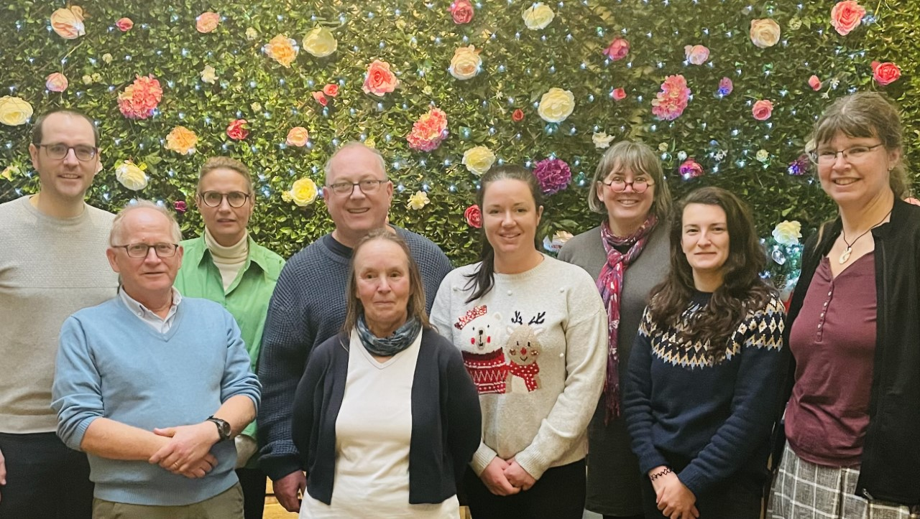
MEDIN Core Team and some familiar faces
Colm
Clare
Gaynor
Charlotte
Helen
Roseanna

Slide 18
MEDIN established
Marine Gazetteer republished
Metadata standard published
First data guideline published
Review of access to industry data
‘2 clicks to data’ initiative
2022
1995
2021
2008
2009
2020
2010
2011
2012
2014
2019
2023
2013
2016
2017
2018
2015
MEDIN precursor established
Trialled new API standard, a global first
MEDIN DAC network expanded
MEDIN DAC network established
Training workshops moved online
MEDIN portal redeveloped
MEDIN portal launched
Benefit to cost ratio estimated at 8:1
Value chains in public marine data
UKDMOS launched
With thanks and acknowledgement to all the sponsors and partners helping to deliver MEDIN’s vision.
@MEDIN_marine

Slide 19
Marine Gazetteer republished
2023
Planning for the future
Developing a new Business Plan to ensure the national framework for managing marine data continues to meet the needs of our varied stakeholders.
With thanks and acknowledgement to all the
sponsors and partners
helping to deliver MEDIN’s vision.
MEDIN established
First data guideline published
Metadata standard published
Review of access to industry data
‘2 clicks to data’ initiative
2022
1995
2021
2008
2009
2020
2010
2011
2012
2014
2019
2023
2013
2016
2017
2018
2015
MEDIN precursor established
Trialled new API standard, a global first
MEDIN DAC network expanded
MEDIN DAC network established
Training workshops moved online
MEDIN portal redeveloped
MEDIN portal launched
Benefit to cost ratio estimated at 8:1
Value chains in public marine data
UKDMOS launched
With thanks and acknowledgement to all the sponsors and partners helping to deliver MEDIN’s vision.
@MEDIN_marine

